Slide 1
Smart Client Patterns
All sections to appear here

Slide 2
Introduction
pptPlex Section Divider
The slides after this divider will be grouped into a section and given the label you type above. Feel free to move this slide to any position in the deck.

Slide 3


Slide 4


Slide 5
The Application
pptPlex Section Divider
The slides after this divider will be grouped into a section and given the label you type above. Feel free to move this slide to any position in the deck.

Slide 6

Requirement
"I just want to search for clients"

Slide 7
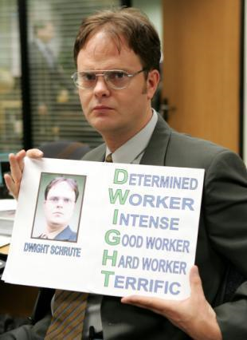
The Developer
Dwight Schrute

Slide 8
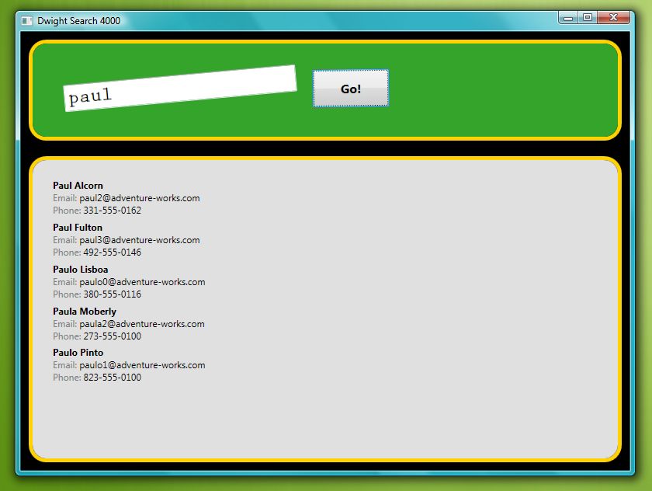

Slide 9

Michael's Vision
"It needs to be advertising supported. And allow us to search anything."

Slide 10

You
Jim Halpert

Slide 11
New Goals
Prepare for multiple search providers
Implement an optional advertising system

Slide 12
The Code
pptPlex Section Divider
The slides after this divider will be grouped into a section and given the label you type above. Feel free to move this slide to any position in the deck.

Slide 13
The CODE

Slide 14
What's wrong with it?
UI depends on AdventureWorks
UI could be split up
Log class sucks
UI code can't be tested

Slide 15
Loose Coupling
pptPlex Section Divider
The slides after this divider will be grouped into a section and given the label you type above. Feel free to move this slide to any position in the deck.

Slide 16
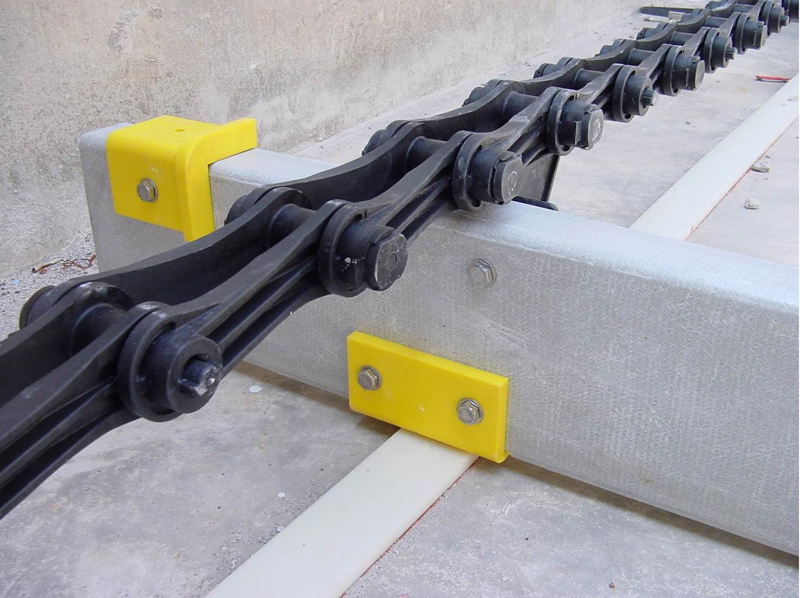
Loose Coupling

Slide 17
TODO:
Turn the Log into an interface
Divide up the UI
Create an interface for search providers

Slide 18
Divding the UI

Slide 19
In Action

Slide 20
What did we see?
Coding to an interface
Ilog
ISearchProvider
Reducing responsibilities
Search Input vs. Search Results
IOC to resolve services and their depedencies
Castle Windsor

Slide 21
What needs work?
Still a lot of code in the UI

Slide 22
Model View Presenter
pptPlex Section Divider
The slides after this divider will be grouped into a section and given the label you type above. Feel free to move this slide to any position in the deck.

Slide 23
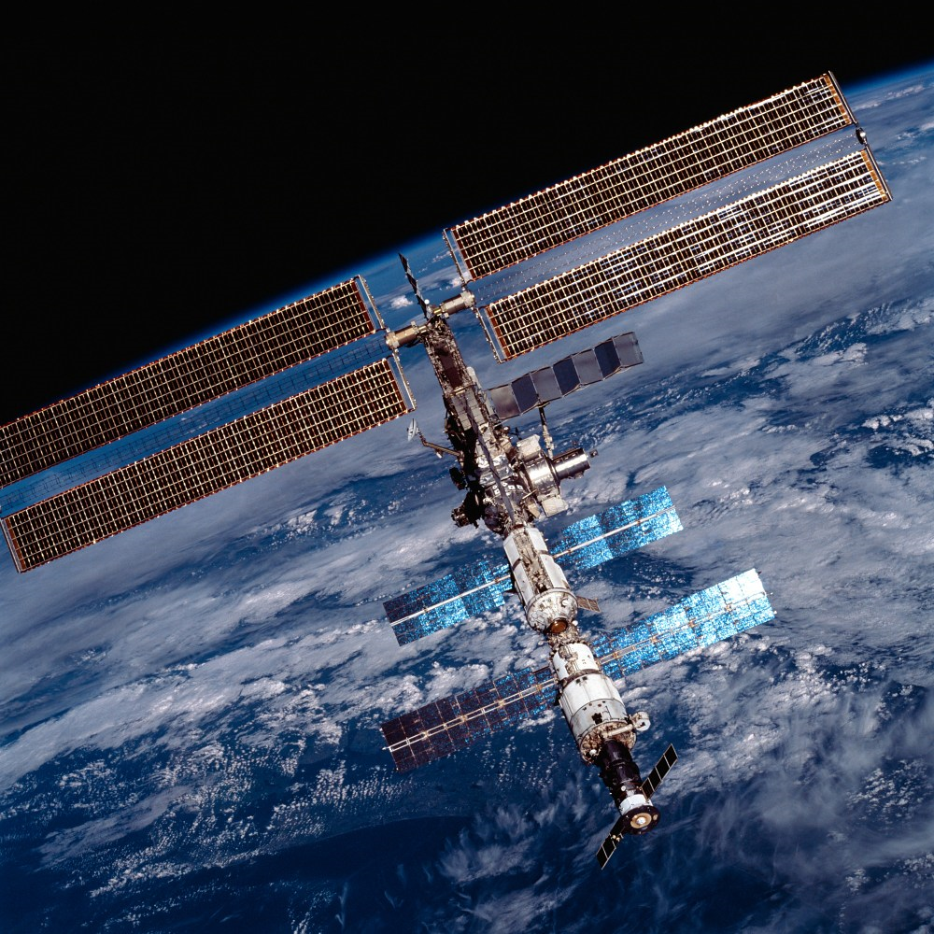
Model View
Presenter

Slide 24
What is it?
View
Presenter
Model

Slide 25
In Action

Slide 26
What did we see?
View is very simple
Very limited code
Presenter has mode of the logic
Presenter talks to view via interface
Presenter has mode of the logic
Presenter is testable and reusable

Slide 27
Presentation Model
pptPlex Section Divider
The slides after this divider will be grouped into a section and given the label you type above. Feel free to move this slide to any position in the deck.

Slide 28
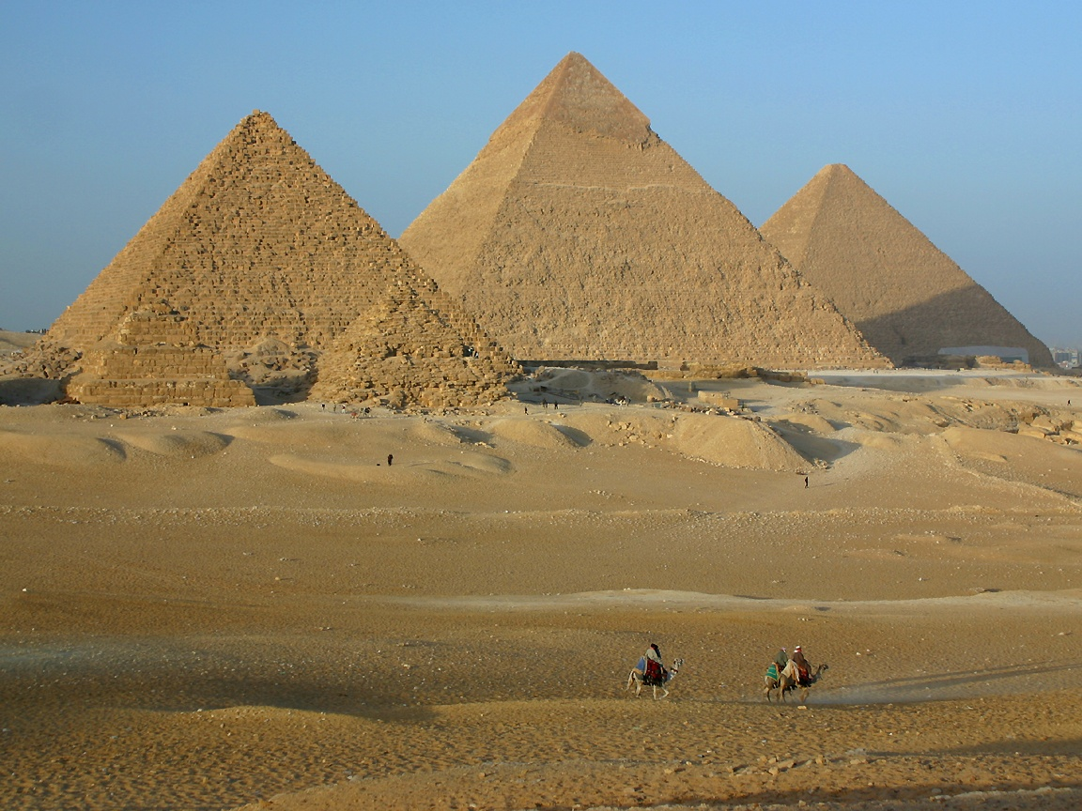
Presentation Model

Slide 29
What is it?
View
Presentation Model
Model

Slide 30
In Action

Slide 31
What did we see?
View is very simple
Very limited code
View comes first
View Model manages state and logic
View Model has no idea about the View

Slide 32
Composite WPF
pptPlex Section Divider
The slides after this divider will be grouped into a section and given the label you type above. Feel free to move this slide to any position in the deck.

Slide 33
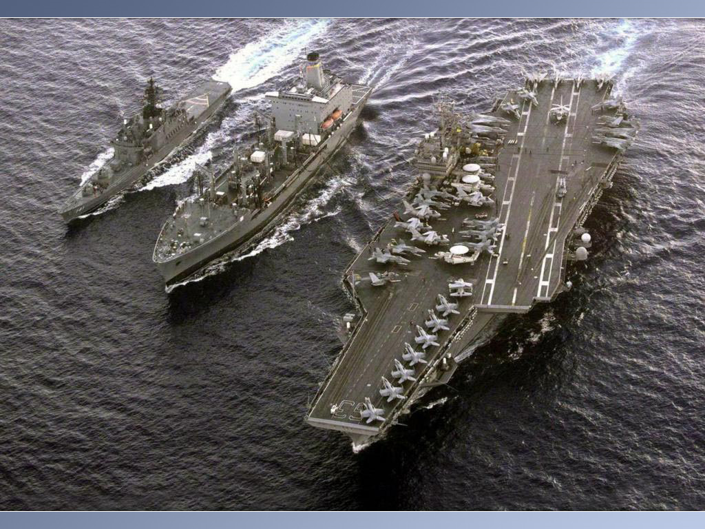
Composite WPF

Slide 34
What is it?
Guidance from P&P
Supercedes C.A.B.
Rewritten for WPF

Slide 35
Helps with Three Things
Modularity
UI Composition
Event Broadcasting

Slide 36
Modularity

Slide 37
Regions (Bottom-Up Composition)
Shell
Top Region
Content Region
Sidebar

Slide 38
Event Broadcasting

Slide 39
Currently
Advertising View
ISearchInputView
Search Results View

Slide 40
With Event Aggregator
ISearchInputView
Advertising View
Hub
Advanced Search Input
Search Results View

Slide 41
What did we see?
Breaking the application into modules
Limited, clear dependencies between modules
UI composition with regions
Event Aggregator

Slide 42
Summary
pptPlex Section Divider
The slides after this divider will be grouped into a section and given the label you type above. Feel free to move this slide to any position in the deck.

Slide 43
Summary
We looked at:
Loose Coupling and IOC
Model-View-Present and Presentation Model
Composite WPF
Best design pattern: KISS

Slide 44
Thanks!
paul.stovell@readify.net
www.paulstovell.com

